Slide 1



Formation Big Data
Projet de Fin d’Etude
Olympic Games
Stagiaires
Houda OUALI ALAMI
Arthur TCHAMOKOUEN CHEPING
Grégoire RESVE
Romain ADANLETE
Responsables Formation
Mehdi TAZI
Razika BELHADDAD

Slide 2
Summary
Appendix
Demo
Summary

Slide 3
UC1 – Datalake Architecture - Structures
1- User (technical and normal users) Technical users creation In order to manage security and access concerns /user/<username> Exemples: /user/dev_jo /user/arthur_t 2- Application to run For applications management purpose /<env>/app/<projectname>/bin ../lib ../config ../oozie ../tmp ../logs ../scripts {sh, bash, …} /<env>/app/<projectname>/hive | 3- Data to store Data storage structure a- Raw data Place to store initial data without modification to ensure tracability /<env>/raw/<dataname>/data/version=current /<env>/raw/<dataname>/data/version=<YYYYMMDD> /<env>/raw/<dataname>/hive Exemples: /dev/raw/JO/data/version=current /prd/raw/JO/data/version=20190709 b- Lake data Place to store processed data for BI usage /<env>/lake/<dataname>/data /<env>/lake/<dataname>/hive Exemples: /dev/lake/JO/data/ /prd/lake/JO/data/hive

Slide 4

UC1 – Architecture - Processing workflow
Oozie is used as scheduler.
All tasks are executed via Oozie workflows.
Some are called using manual command (On Request).
Others are called via a workflow behind an Oozie coordinator.

Slide 5
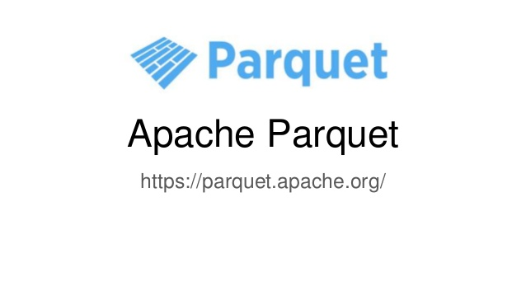

UC1 – Architecture - File types
Different filetypes are used to process all tasks :
- CSV filetype to store native data (data without any change)
- PARQUET filetype to help on analytic queries (faster processing as compared to other formats).

Slide 6

UC1 - Architecture - Tables
Two types of tables will be created: external tables and managed tables
Hive is used to manage (help to query) data already present in HDFS datalake:
External tables: they will provide view on data already present. We can then easily request data. Ex: dev_lake_jo.jo_full_games
Managed(internal) tables: we will use this kind of table to store calculated data. In these tables, the data will be reset for each recalculation. So, each time new data will be received, the table will be truncated and populated anew.
dev_lake_jo.jo_top5_male_female_last_games
dev_lake_jo.jo_top5_athletes_per_country

Slide 7

UC1 - Architecture - Technologies
Since a complex system is required to allow data exposure from our datalake…
In case we should install a complex system to permit to expose data via our datalake, many tools/technologies are used:
- HDFS Hadoop File Sytem for our datalake,
- Oozie to schedule tasks, (for tasks scheduling)
- Hive to expose data,
- Scala/Spark to facilitate « complexe » ingestion,
- Shell to scripts some actions which will be called via Oozie workflows.
Shell scripts to carry out some processsings triggered Oozie workflows.

Slide 8


UC1 – Scripts - Ingestion - Raw
As explained in previous slide, Scala/Hadoop FileSystem(Spark) is used to ingest data.
The files we have to ingest in the datalake are stored into a folder on our cluster.
Each data file contains information for the same «year » and « season ». The filename pattern is <year>-<season>.csv
Ex : 1896-Summer, 2014-Winter.
Each time the workflow will run and a file is found in the folder, it will be ingested in the raw space set in datalake.
If a same « year-season » already exists into raw, it will be archived into specific timeline (versionning)folder before the ingestion occurs.
The file present into host is moved into « done » folder to avoid additional copy.
Example of HDFS path in the dev environment:
/dev/raw/JO/data/version=current/2016-summer/xxxxx.csv
Example of archive path:
/data/raw/JO/data/version=20190709/2016-summer/xxxxx.csv
Schema: Appendix 1.1 (todo)
Notes:
Les fichiers traités par le processus d’ingestion sont mis dans le répertoire « done » afin de garder une traçabilité des fichiers traités et d’éviter de réingérer le fichier s’il était resté dans le répertoire.

Slide 9
UC1 – Scripts - Ingestion - lake
Same here, Scala/Spark is used to transform csv files to parquet files.
Each time the workflow runs, the parquet files will be replaced.
A path example : /dev/lake/JO/data/Games=2016-Summer/xxxxx.parquet
(todo faire fonctionner la copie sur le Lake)
Schema: Appendix 1.2 (todo)
Notes:
Transformed files are stored into a specific folder on the cluster. This folder is « lake ».
The parquet files will be regenerated each time the workflow will run

Slide 10


UC1 – Scripts - Metric tables
Assuming data is available in the lake in parquet format:
First : create a Hive external table for the whole parket file storage
Second : create managed tables based on previous external table. This will enable to generate new data, that is « Metric data ».
8 managed tables, one for each of the 8 metrics requested in UC1.
6 managed tables, one for each of the 6 BI metrics used in UC2.
Scripts : Appendix 1.3.1 - External table
Scripts : Appendix 1.3.2 - Managed tables

Slide 11
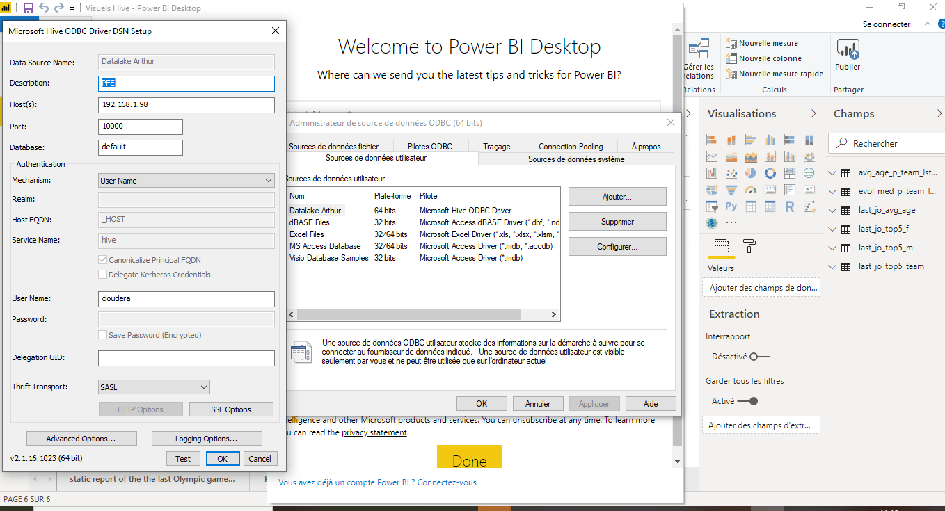

UC2 – Data Visualization
In order to load the data on which reports and charts are based,
we have connected the reporting tool Power BI on Hive platform using an ODBC connector .

Slide 12

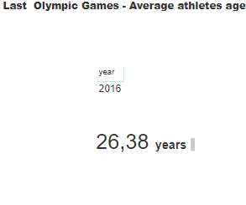
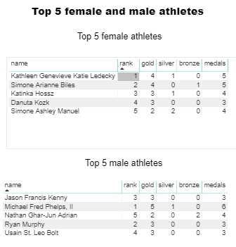
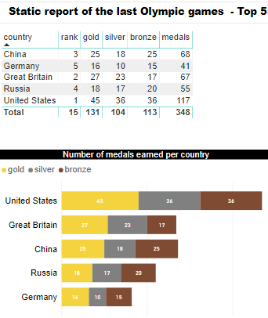
Static reports of the last Olympic Games

Slide 13
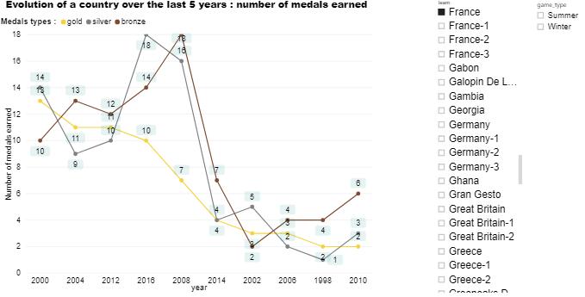
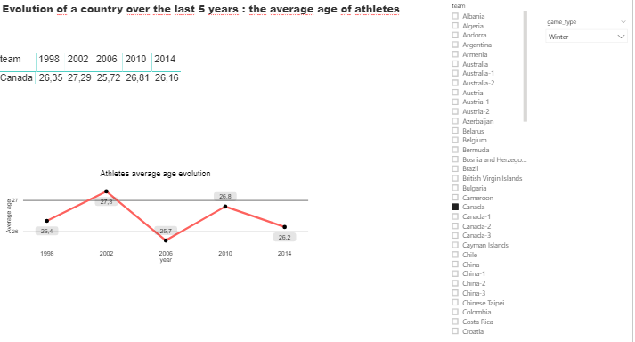
Dynamic charts showing evolutions of a country over the last 5 years

Slide 14
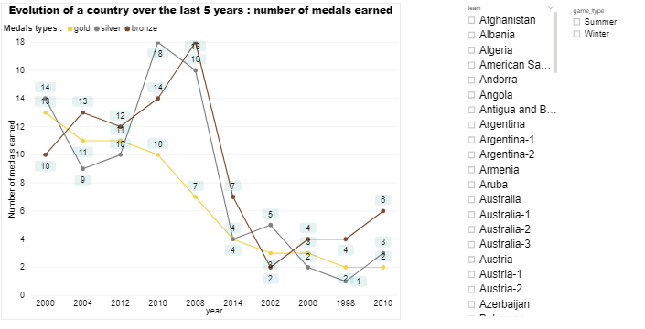
Evolution of a country over the last 5 years

Slide 15
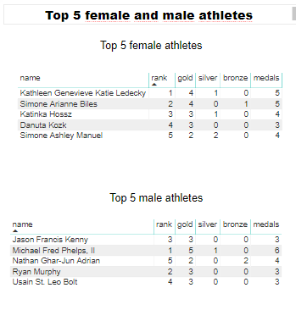
TOP 5 female and male athletes

Slide 16
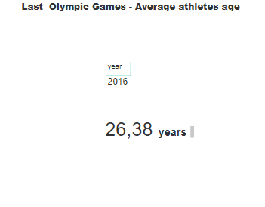
Static report of the last Olympic games The average athletes age

Slide 17
UC3 – Database choice 1/2
Because lot of random R/W operations are done and because the volume is big but not very huge (less than Pbytes), we have chosen an Operational Database : a Relational Database or a NoSQL Database.
To determinate what kind of databases we need, we have used the CAP principles.
As the tables are to be designed by query, NoSQL database are definitely more suitable.
Because Availability is not really required we can pick a database for which Partition Tolerance and Consistency requirements are respected. In this case the range is somewhat wide : Cassandra, MongoDB, Hbase, CosmosDB.
The choice of the database was based on an selection matrix.
Notes:
Les modifications étant petites et nombreuses, plus la volumétrie relativement peu élevée, HDFS n’est pas adaptée. Perf.

Slide 18



UC3 – Database choice 2/2
To determinate which database to use, we have used a multi criteria matrix.
According to the matrix in our context the best choice is MongoDB Database.
 | Weight | MongoDB | Cassandra | Hbase
Cost | 1,5 | 4 | 4 | 5
Avaibility | 0,5 | 3 | 4 | 3,5
Consistency | 1 | 4 | 3 | 4
Language | 2 | 4 | 2,5 | 1
Total | 5 | 3,9 | 3,2 | 3,05

Slide 19
UC3 – Technologies
To help operational team to request our MongoDB database, we propose them different tools to manage (administration) collections and documents :
Terminal
Robo 3T
Studio 3T
Robo 3T is a free version. It’s easy to install and manipulate.
Notes:
A supprimer????

Slide 20
UC3 – Document Structures
To execute near real time(précisions d’Arthur) R/W operations, our operational database should have documents which expose all fields for which modifications can be done.
As no restriction has been given, we consider the possibility to modify all fields (exept athlet ID).
The modifications occur only for the last game.
The Collection which stores our documents is named : JO.LastGames
The structure example can be found in Appendix 3.1

Slide 21
UC3 – MongoDB - Initial load scripts
We use Scala/Spark to copy data from datalake to our MongoDB collection.
Scripts consist in initiating a SparkSession with some settings relating to mongodb :
.config("spark.mongodb.input.uri", "mongodb://localhost:27017/JO.LastGames")
.config("spark.mongodb.input.readPreference.name", "secondaryPreferred")
.config("spark.mongodb.output.uri", "mongodb://localhost:27017/JO.LastGames")
Once a dataframe is created using the same SparkSession based on source data, we transform it in rdd
Then the rdd is written into mongodb database using a specific class from :
import com.mongodb.spark.MongoSpark
Scripts : Appendix 3.2

Slide 22
UC3 – DesignByQuery Structure 1/2
Optimized document designed to return the list of the best athletes per country and per sport. Used for research purpose and not for modification.
BestAthletesByCountryAndSport
ID | Integer
Name | String
City | List
Sport | String
Rank | Integer

Slide 23
UC3 – DesignByQuery Structure 2/2
Optimized document designed to return the list of athletes per range of weight (40-, 40-60, 60-80, 80-100,100+)
AthletesByWeightCategory
ID | Integer
Name | String
WeightRange | List

Slide 24
Appendix – 1.1

Slide 25
Appendix – 1.1
Script Scala/Spark tournant via la commande
spark-submit xxxxxxxx
Le script est lancé via la commande Oozie :
oozie job --oozie http://your_host:11000/oozie -config cluster_conf.xml -run

Slide 26
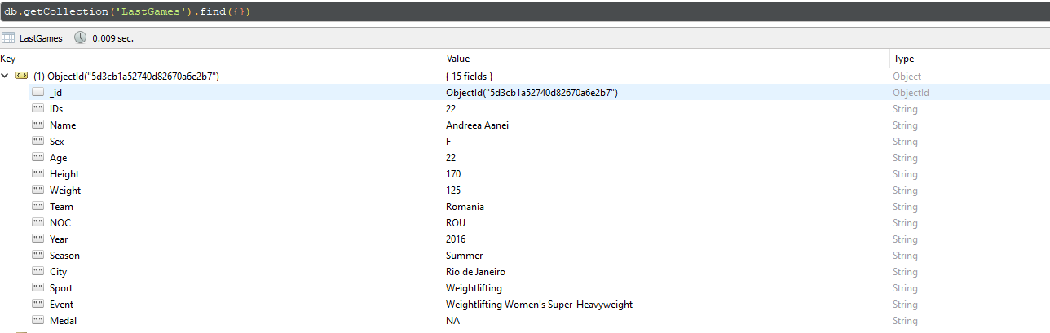
Appendix – 3.1

Slide 27
Appendix – 3.2
use JO db.system.js.save( { _id: "insertBatch", value : function(collection, documents) { var bulkInsert = collection.initializeUnorderedBulkOp(); var insertedIds = []; var id; documents.forEach(function(doc) { id = doc._id; // Insert without raising an error for duplicates bulkInsert.find({_id: id}).upsert().replaceOne(doc); insertedIds.push(id); }); bulkInsert.execute(); return insertedIds; } } ) | db.system.js.save( { _id: "copyDocuments", value : function(sourceCollection, targetCollection, filter, batchSize) { print("Moving " + sourceCollection.find(filter).count() + " documents from " + sourceCollection + " to " + targetCollection); var count; while ((count = sourceCollection.find(filter).count()) > 0) { print(count + " documents remaining"); sourceDocs = sourceCollection.find(filter, {Name:1, Year:1}).limit(batchSize); idsOfCopiedDocs = insertBatch(targetCollection, sourceDocs); targetDocs = targetCollection.find({_id: {$in: idsOfCopiedDocs}}); //deleteBatch(sourceCollection, targetDocs); } print("Done!") } } ) db.loadServerScripts(); copyDocuments(db.getCollection('LastGames'), db.getCollection('AthletesByWeightCategory'), "", 1000)

